Slide 1
PREDICTING HEART DISEASE USING BASE LEARNING ALGORITHMS AND ENSEMBLE CLASSIFIERs
UNDER THE GUIDANCE OF
DR. RUCHIKA MALHOTRA
(HOD, SE, DTU)
PRESENTED BY:
Suman Nandi
2k20/swe/23
Minor Project (SWE5302)

Slide 2
INTRODUCTION
Heart related diseases or Cardiovascular Diseases (CVDs) are the main reason for a huge number of death in the world over the last few decades and has emerged as the most life-threatening disease, not only in India but in the whole world. So, there is a need of reliable, accurate and feasible system to diagnose such diseases in time for proper treatment.
In this project, the presence of heart disease is predicted by employing Multinomial Naïve Bias Logistic Regression (LR), and Decision Tree (DT).
Along with this we have used one of the ensemble classifiers i.e. bagging., boosting and stacking
We have taken various parameters into account such as Accuracy, Precision, Recall and F1-score in order to analyze the performance and conducted a comparative study of the various models used.

Slide 3
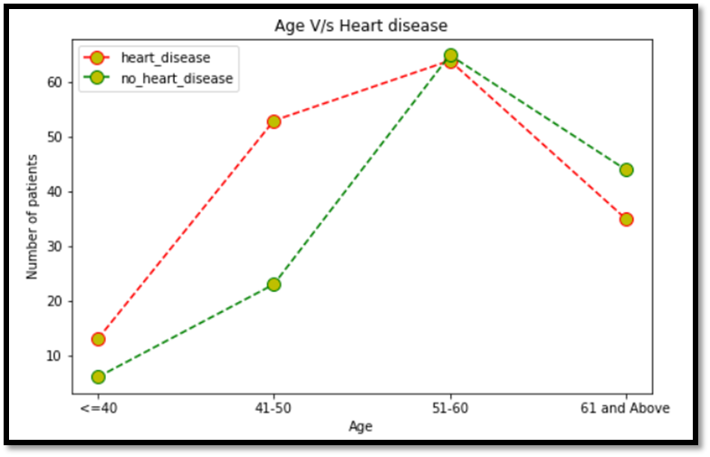
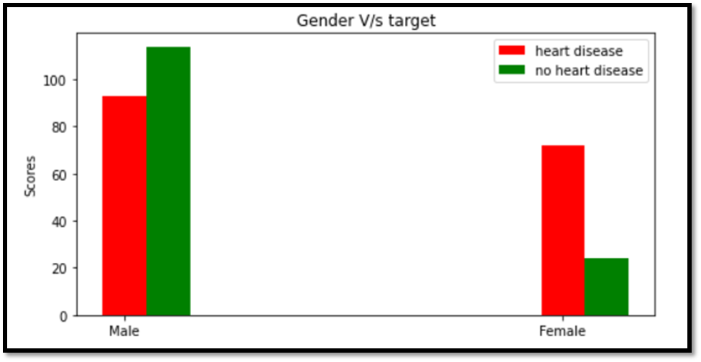
OVERVIEW OF DATASET USED
The dataset is taken from Kaggle consisting of 303 rows and 14 columns.
From the line graph, it can be concluded that in the age group ranging from 41-60 years, the rate of heart disease is the highest.
The number of males and females in the dataset is 207 and 96, respectively. Out of 207 males 93 have a heart disease and out of 96 females 72 are suffering from a heart disease.

Slide 4
BASE LEARNING AND ENSEMBLE TECHNIQUES
Logistic Regression:- Logistic regression is a supervised learning classification algorithm used to predict the probability of a target variable.
Multinomial Naïve Bayes:- The multinomial Naive Bayes classifier is suitable for classification with discrete features
Decision Tree:- Decision Tree is a supervised learning technique that can be used for both classification and Regression problems.
Bagging :- It refers to the variance of the model. It is also known as bootstrap aggregation. Bagging is the application of the bootstrap procedure, which improves the stability of a model by improving accuracy and reducing variance, thus reducing the problem of overfitting.
Boosting: A form of weighted averaging of models where each model is built sequentially via taking into account the past model performance.
Stacking: It means making predictions of a number of models in a hold-out set and then using a different model to train on these predictions.

Slide 5
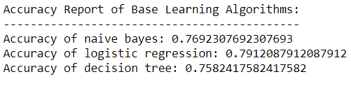
ACCURACY REPORT
This slide shows the accuracy report of Base Learning Algorithms.

Slide 6
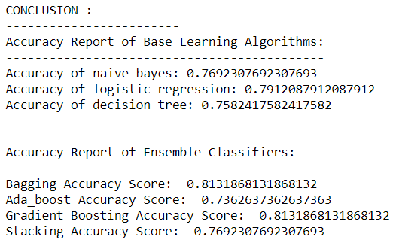
CONCLUSION
This innovative project attempts to predict the presence of heart disease by utilizing base learners, ensemble combination rules and ensemble classifiers.

Slide 7
REFERENCES
Ghotra, B., Mcintosh, S., & Hassan, A. E. (2015, may). Revisiting the impact of classification techniques on the performance of defect prediction models. In proceedings of the 37th international conference on software engineering-volume 1 (pp. 789-800). IEEE press.
Panichella, a., Oliveto, R., & De lucia, A. (2014, february). Cross-project defect prediction models: l'union fait la force. In 2014 software evolution week-ieee conference on software maintenance, reengineering, and reverse engineering (CSMR-WCRE) (pp. 164-173). Ieee.
Mendes-moreira, j., Soares, C., Jorge, A. M., & Sousa, J. F. D. (2012). Ensemble approaches for regression: A survey. Acm computing surveys (csur) , 45 (1), 10.
Tavish srivastava “ basics of ensemble learning explained in simple english ” analyticsvidhya.Com.
Di Nucci, D., Palomba, F., Oliveto, R., & De Lucia, A. (2017). Dynamic selection of classifiers in bug prediction: An adaptive method. IEEE Transactions on Emerging Topics in Computational Intelligence , 1 (3), 202-212

